Slide 1
Global Positioning System Basics.
GPS
GNSS
RTK
PNT
Position Navigation Time

Slide 2
GPS Architecture
Operated by the US Department of Defense
Available worldwide
An independent system
Consists of three segments:
  1. Space
  2. Control
  3. User

Slide 3
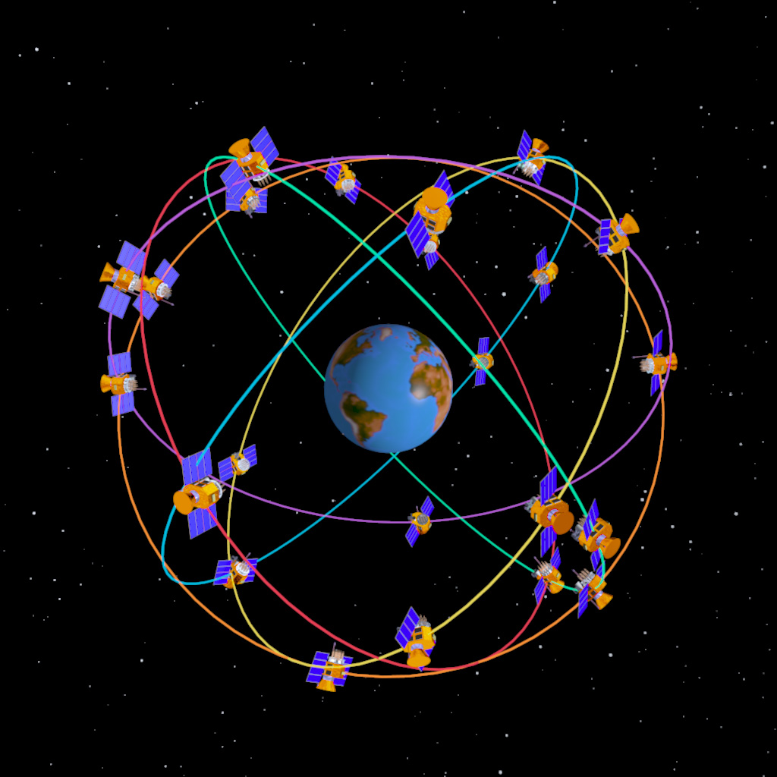
The constellation
24 satellites in high orbit, ~ 20,000 Km
There are six orbital planes, equally spaced (60 degrees apart), and inclined at fifty-five degrees with respect to the equatorial plane.
12 hour orbital period
Positioned so a minimum of 5 satellites are visible at all times.
Each satellite transmits time, information about the constellation, and information about itself on two L-band frequencies
L1 (1575.42 MHz) is used by low cost receivers

Slide 4
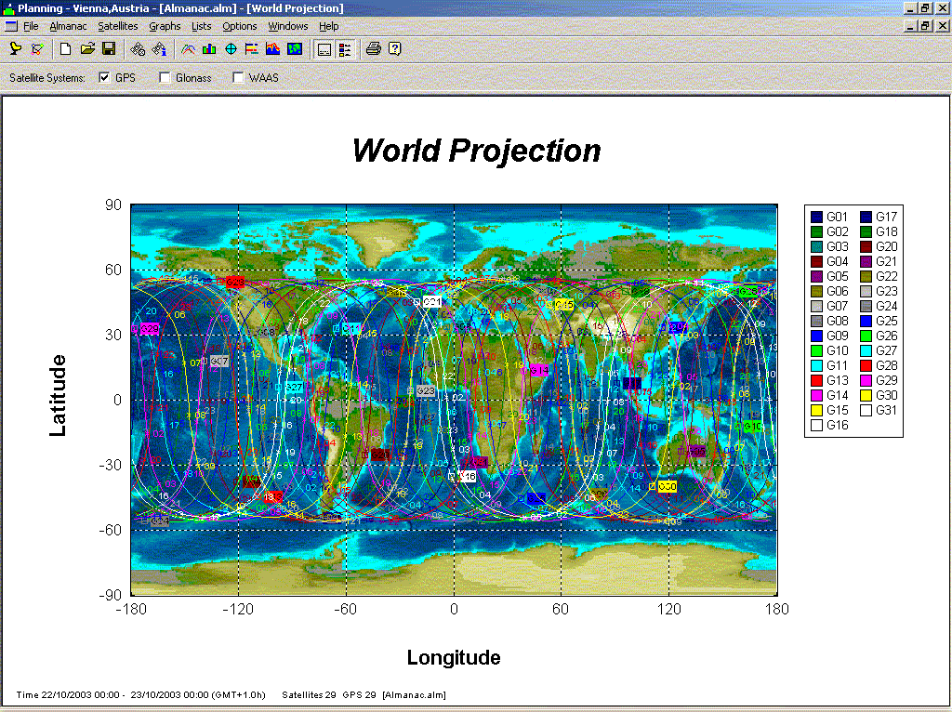

Slide 5
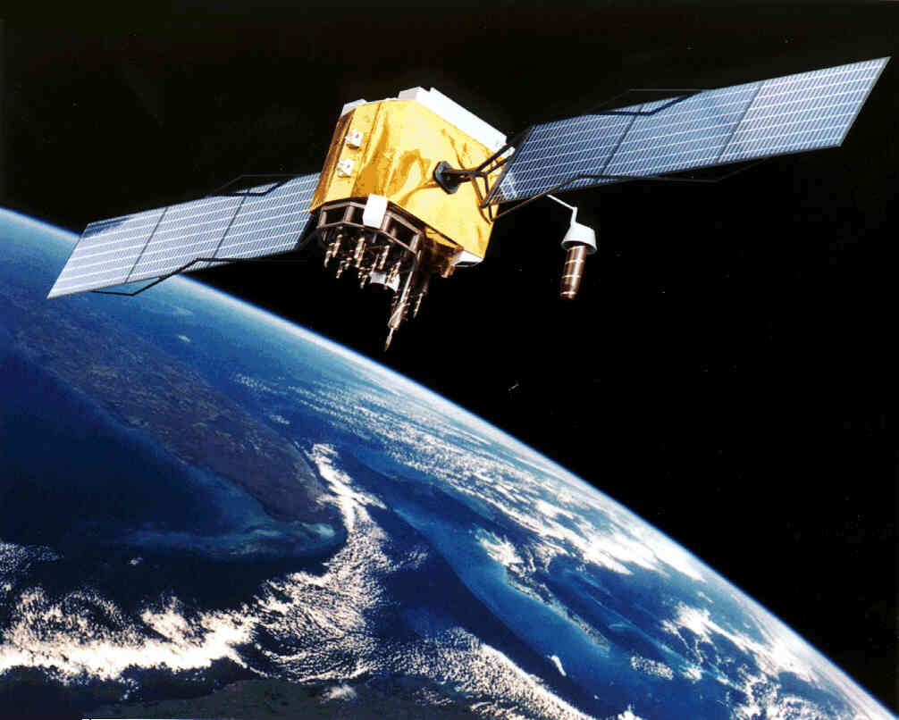
GPS Space Vehicle
Broadcast power is approx. 22 watt
4 Atomic clocks per space vehicle
Signal Strength at planet surface:
–123 dBm to –130 dBm
Received signal is below RF Noise floor:
It’s very, very weak.

Slide 6
Ground Monitoring stations
Colorado
Springs
Cape Canaveral
Kwajalein
Hawaii
Ascention
Diego Garcia
Master Control Station
Prelaunch Checkout Station
(Functional Ground Antenna)
Monitor Station
Ground Antenna
Notes:
The constellation is constantly monitored and revised data uplinked.

Slide 7
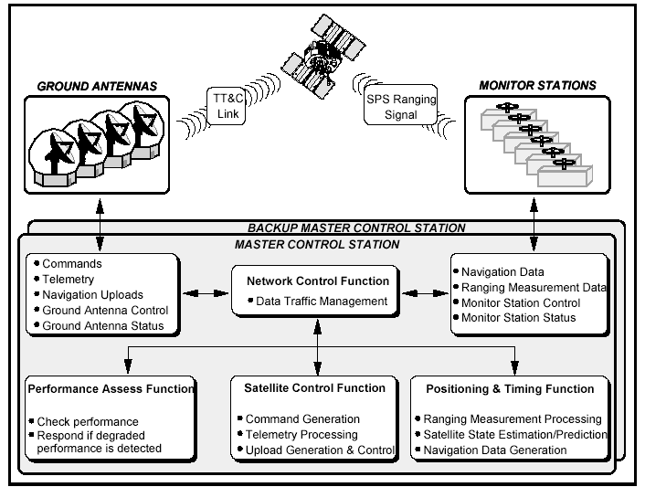
Control segment

Slide 8
The GPS L1 Signal.
The GPS L1 signal has three components:
1. C/A Code - Coarse Acquisition Code
2. Navigation message – Almanac, ephemeris, Satellite health, satellite clock corrections etc.
3. P- Code (Y-Code when encrypted)

Slide 9
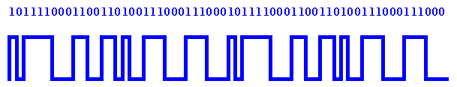
GPS C/A Code
Each satellite generates a unique pseudorandom code
The code is 1023 chips long and repeats every millisecond.
Sometimes called ‘ranging code’.
This code is complex and resembles random noise.
But, we know the code structure for each satellite.

Slide 10
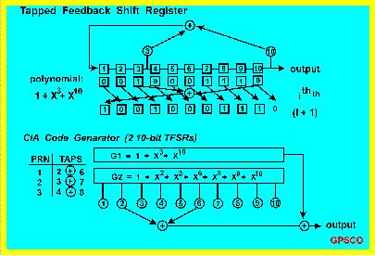
Receiver generated code
As the code structure is known it can be generated inside the GPS receiver.
The receiver then compares its generated code with the received signal from the satellite.

Slide 11
Pseudorange Determination
Receiver code
Satellite Code
Pseudorange

Slide 12

Distance to the satellite.
When the codes match, this allows us to amplify, and measure the time differential and then track the satellite signal.
From the time differential we can calculate our distance from the satellite (pseudorange)
Time x Speed of light = Distance
The C/A code gives us the range (distance) to the satellite but it contains errors, some of these are corrected using information from the Navigation message.

Slide 13
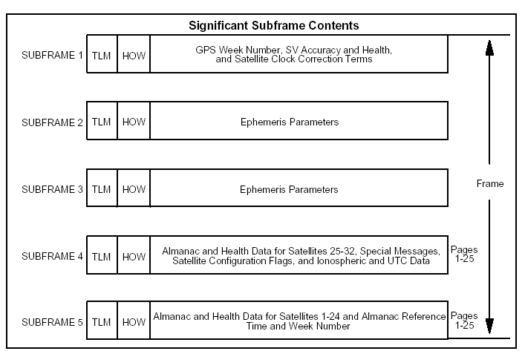
To know the satellites position we need the Navigation Message
The GPS Navigation Message consists of time-tagged data bits marking the time of transmission of each subframe at the time they are transmitted by the SV.
A data frame is transmitted every thirty seconds and contains 2 pages of the 50 page Almanac

Slide 14
Navigation message contents.
GPS week number
  The number of weeks since midnight on the evening of 05 January 1980 / morning of 06 January 1980, However the satellite actually reports GPS week beginning 22 August 1999, GPS manufacturers add 1024.
SV accuracy and Health
  Predicted User Range Accuracy, this number is the estimate of the combined error due to the broadcast ephemeris.
  Heath – Indication of satellite health.
Ionosphere and UTC data
  Ionospheric data that is used by the receiver to form an approximate model of the ionospheric delay.
  UTC data- GPS to UTC offset plus data allowing the user to accurately link GPS to UTC time.
Almanac
  Almanacs are approximate orbital data parameters for all SVs. The 10 Keplerian element almanacs describe SV orbits over extended periods of time (useful for months in some cases) and a set for all SVs is sent by each SV over a period of 12.5 minutes (at least).
Ephemeris
  See next page

Slide 15
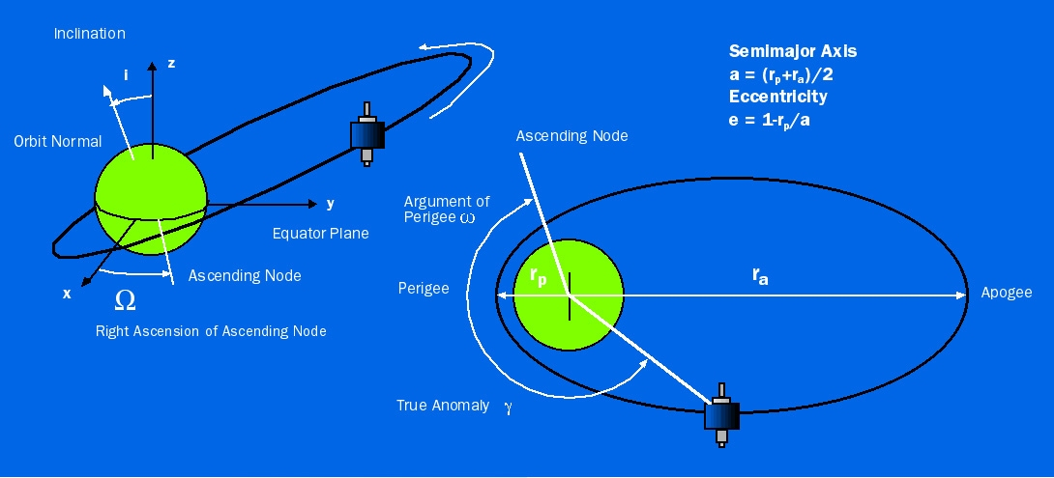
Ephemeris
Ephemeris data describes each satellite orbit for short periods, using 20 Keplerian elements.
A receiver gathers new ephemeris data each hour, but can use old data for up to four hours without much error.

Slide 16
Satellite position.
The Ephemeris is used by the GPS receiver’s algorithms to define the exact satellite position at any given time.
The C/A code gives us the approximate range, it’s corrected using data within the Navigation message.
Combine both and you have your position some where on a sphere.
With One Satellite - one measurement narrows down our position to the surface of a sphere
We're somewhere
on the surface of
this sphere.

Slide 17
Calculating a position using trilateration
We have established our position on a sphere using one satellite.
By measuring distance from several satellites we can calculate our relative position on the globe. This method is known as trilateration.

Slide 18
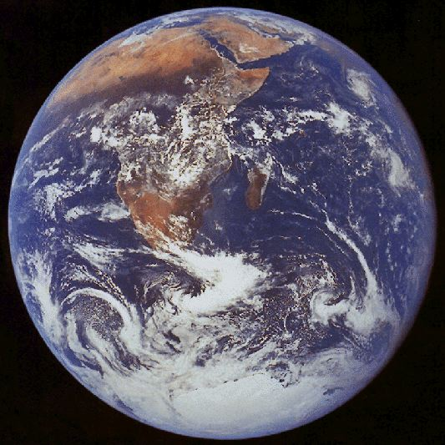
Two satellites
A Second measurement yields an intersection of two spheres
Intersection of two
spheres is a circle

Slide 19
Three satellites
A third measurement narrows location to two points.
However, we can discard one point because it will be a nonsense answer out in space or moving at very high speed

Slide 20
Four satellites
The fourth satellite discards the nonsense point.
The fourth satellite provides three more redundant trilateration measurements that are averaged and thereby cancel your receiver's time related errors
This is called a 3D, 3 Dimensional, position fix as it also provides altertude.

Slide 21
GPS Error Sources (meters)
  Standard L1 GPS
Satellite clock error 1.5
Satellite orbit error 2.5
Ionosphere error 5.0
Troposphere 0.5
Multipath and receiver errors 0.8
Total Error 10.3m
With more processing power for filtering, plus with a good antenna, a L1 C/A code GPS receiver can achieve position accuracy of <2.5m with a 50% probability.
Newer L1 receivers are now capable of receiving multiple constellations, typically GPS, GLONASS and BEIDOU, giving more satellites in clear line of sight and therefore able to achieve accuracies of 1.5m.

Slide 22
Ionospheric Effects
Ionosphere is a layer of the atmosphere filled with charged particles that delay the signal from the satellite to the receiver.
Notes:
Ionosphere is a layer of the atmosphere filled with charged particles that delay the signal from the satellite to the receiver.

Slide 23
Multipath
Notes:
Mountains, trees, towers, and buildings are just a few examples of possible obstructions. Remeber, the GPS signal is an RF signal that can easily be blocked. <B>
If obstructions are present, it’s important that you note the azimuth and elevation above the horizon of these structures<B>
You can then account for these in your planning. Also, some structures that are obstructions in one direction can also be sources of multipath in another direction.<B> Beware of other sources of multipath.<B>

Slide 24
GPS as a Source for Accurate time
As we’ve seen, position is based on satellites position and the time the GPS signal takes to reach us, remember;
Time x Speed of light = Distance?
If the receiver is stationary, we now know Distance and hence position.
By averaging a number of positional readings we can increase the accuracy of our known position, hence increase our timing accuracy.
Using a dedicated timing receiver that surveys all satellites in view over a period of time, we can get time accuracy to UTC down to 15nSec.
This source of time is used in mobile phone, IT, security, digital TV broadcast and many other applications requiring accurate time.

Slide 25
GNSS
Global Navigation Satellite System
  This is the name that covers all navigation satellite systems (constellations) globally
  Includes the main constellations such as GPS, GLONASS, GALILEO, BEIDOU, IRNSS and QZSS
  Also includes the Augmentation satellites systems typically called SBAS, WAAS, etc
The main difference between a GPS and GNSS receiver is that a GPS receiver will only receive the GPS constellation signals, whereas a GNSS receiver should as a minimum receive signals from 2 different constellations plus SBAS
Multi-Frequency receiver is one that can receive multiple signals from the same satellite. These signals are transmitted at different frequencies and given names such as L1, L2, L5 etc.
A GNSS multi-constellation, multi-frequency receiver is used for very high accuracy positioning.

Slide 26
RTK
RTK stands for Real Time Kinematics because it uses the satellite transmitted signal carrier for calculation.
From an architectural point of view, RTK consists of a base station, one or several rover users, and a communication channel with which the base broadcasts information to the rovers at real time.
It uses a Differential GNSS technique, corrections are transmitted from the base station that is in a known surveyed position, and this provides a high precision accuracy relative to the base.
A RTK base station covers a service area spreading about 30 kilometres, and a real time communication channel is needed connecting base and rover. RTK, which achieves performances in the range of a few centimetres, is a technique commonly used in surveying applications.
For more information on RTK please refer to the white paper in this same folder.

